Slide 1

Exercise 2: The Cork Board

Slide 2
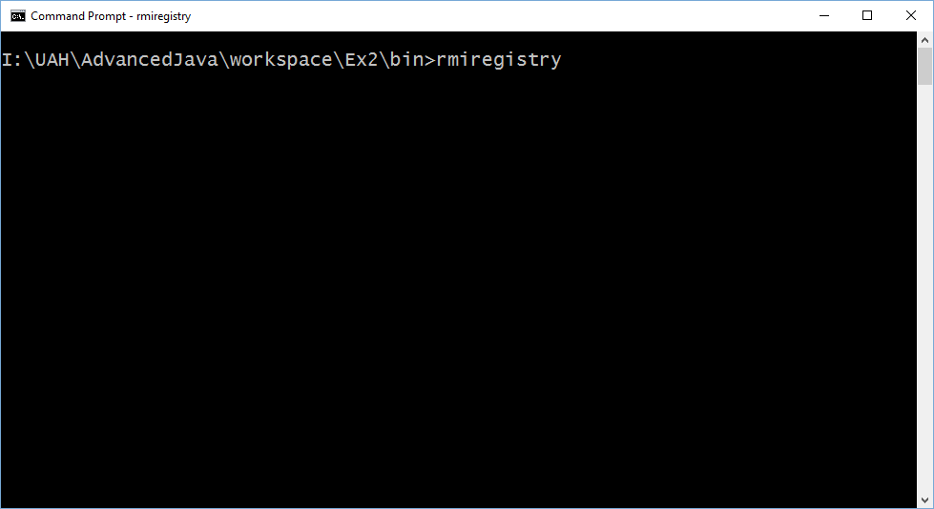
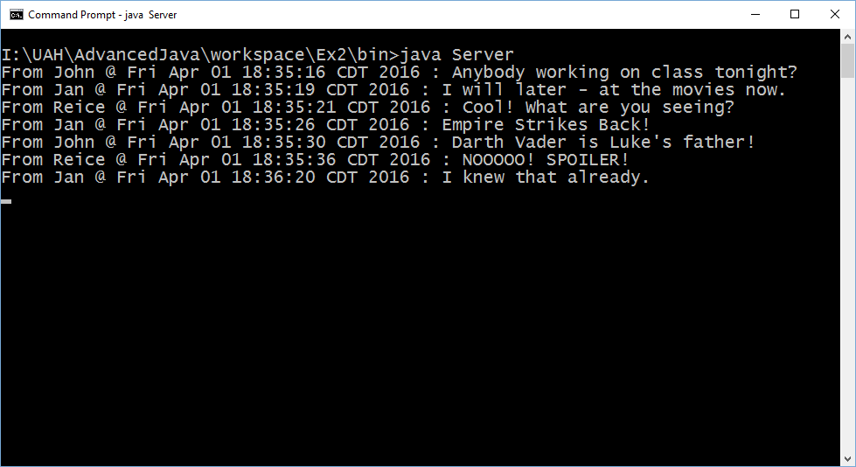
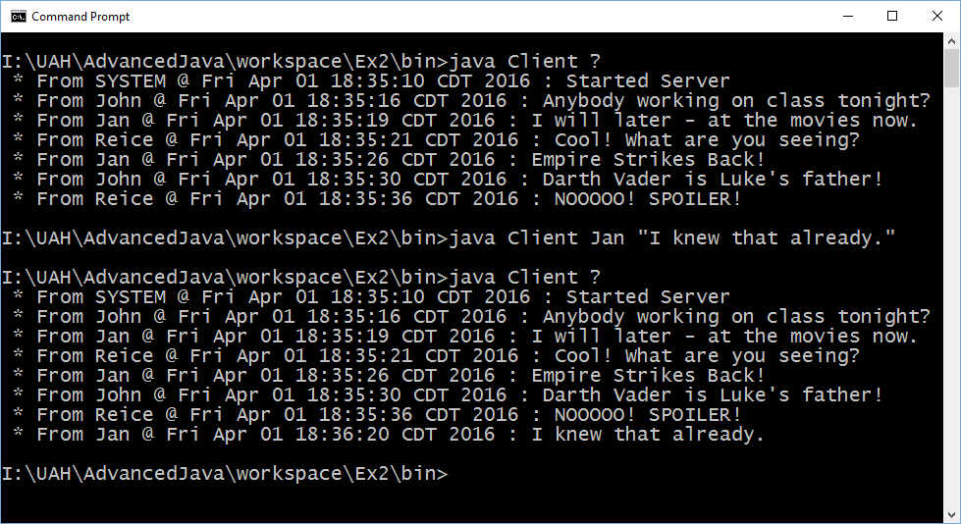
Exercise 2: The Cork Board

Slide 3
Exercise 2: The Cork Board
Create class Message with a String “sender”, a String “message”, and a Date “posted”.
Create the CorkBoard interface:
“postMessage” to send a message
“getMessages” to return the list of accumulated messages
“clearBoard” to erase messages
Create an object that implements CorkBoard. Expose this object through RMI.
Create an RMI client to talk to the CorkBoard. Post some messages and check the board. Clear the board with your client.

